Slide 1

Test Proposal On Instagram
Submitted By:
Abhishek Mahajan

Slide 2


Introduction
This document describes the methods and procedures that will be used in the functional testing process of Instagram web and mobile applications.
It is meant to be used as a manual during testing works. It describes the procedure of the testing process. The test plan is intended for project managers, product developers, and QA engineers.
Reactive Hive is a Bulgarian-Ukrainian
agency, which has been founded by 2 QA engineers of Mid-Senior level. Around 5 years we've been working for a different companies in the US, Europe and Australia, eventually gathered deep expertise of the testing e-Commerce projects, especially based on Magento 2 CMS. Also we have considerable experience in testing different type of projects based on others CMS systems (Shopify, BigCommerce, etc.), and the custom ones as well. In our company we got rid of redundant management layers making accent only on testing.
Flexible resources
Adaptive
About
2

Slide 3
Scope
The scope of the project includes testing the following features of
“https://instagram.com/” web application.
1.2.1 Inclusions
•Login
•Forgot Password
•Post
•Share post
•Post Comment
•save story in gallery
From our understanding, we believe above functional areas need to be Tested.
Reactive Hive is a Bulgarian-Ukrainian
agency, which has been founded by 2 QA engineers of Mid-Senior level. Around 5 years we've been working for a different companies in the US, Europe and Australia, eventually gathered deep expertise of the testing e-Commerce projects, especially based on Magento 2 CMS. Also we have considerable experience in testing different type of projects based on others CMS systems (Shopify, BigCommerce, etc.), and the custom ones as well. In our company we got rid of redundant management layers making accent only on testing.
Flexible resources
Adaptive
About
2

Slide 4
Test Environments
•The operating systems that will be used for testing, such as Ubuntu, macOS.
•The browsers and versions that will be tested, such as Google Chrome, Mozilla Firefox, Microsoft Edge.
•The device types and screen sizes that will be used for testing, such as desktop computers, laptops, tablets, and smartphones.
•The hardware and software requirements for running the test cases, such as a specific processor, memory, or storage capacity.
Reactive Hive is a Bulgarian-Ukrainian
agency, which has been founded by 2 QA engineers of Mid-Senior level. Around 5 years we've been working for a different companies in the US, Europe and Australia, eventually gathered deep expertise of the testing e-Commerce projects, especially based on Magento 2 CMS. Also we have considerable experience in testing different type of projects based on others CMS systems (Shopify, BigCommerce, etc.), and the custom ones as well. In our company we got rid of redundant management layers making accent only on testing.
Flexible resources
Adaptive
About
2

Slide 5
· The security protocols and authentication methods that will be used to access the test environment, such as passwords, tokens, or certificates
· The access permissions and roles of the team members who will be using the test environment, such as testers, developers, or stakeholders.
• Ubuntu – Chrome, Firefox and Edge
• Mac OS – Safari Browser
• Android Mobile OS – Chrome
• iPhone Mobile OS - Safari
Reactive Hive is a Bulgarian-Ukrainian
agency, which has been founded by 2 QA engineers of Mid-Senior level. Around 5 years we've been working for a different companies in the US, Europe and Australia, eventually gathered deep expertise of the testing e-Commerce projects, especially based on Magento 2 CMS. Also we have considerable experience in testing different type of projects based on others CMS systems (Shopify, BigCommerce, etc.), and the custom ones as well. In our company we got rid of redundant management layers making accent only on testing.
Flexible resources
Adaptive
About
2

Slide 6



WORKFLOW
QA engineer takes part in testing .He can explore flow of instagram application and analyze test requirement
After notifying test requirement test lead create test plan for instagram application
on the basis of test plan QA or tester create a scenerio.
Test cases are written, requirements investigated and analyzed.
Tester can execute test cases on instagram application
If no bugs are found, tester passes the applicattion for production release
If bugs are found tester documents them
Devsx bug and forwards them to testers for regression testing
Cycle continues until all sprints are tested

Slide 7

RESPONSIBILITIES
Manual testing:
Functional, smoke, regression testing
Test documentation design
Compatibility testing (Cross- browser, cross-device)
API testing
User interface testing (UI)
System testing / end-to-end
Requirements analyse
Bug-tracking
Creating test data.

Slide 8
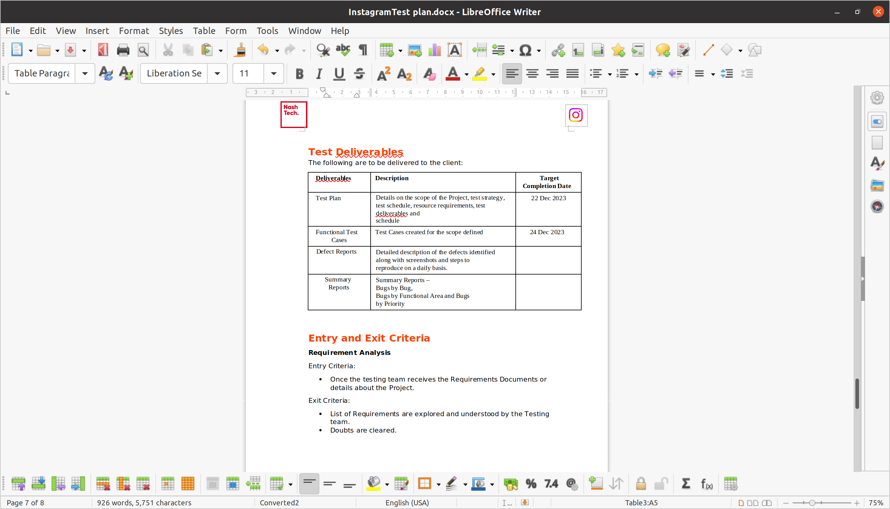
TEST DOCUMENTATION
We are trying to keep a single format across all the test documentation types. Here are some examples:
Test Plan Document:
Test plan Documentation Link
https://1drv.ms/b/s!ArcqqmFm4cG7bEiHA30-kku0OsU?e=sw4FWN

Slide 9
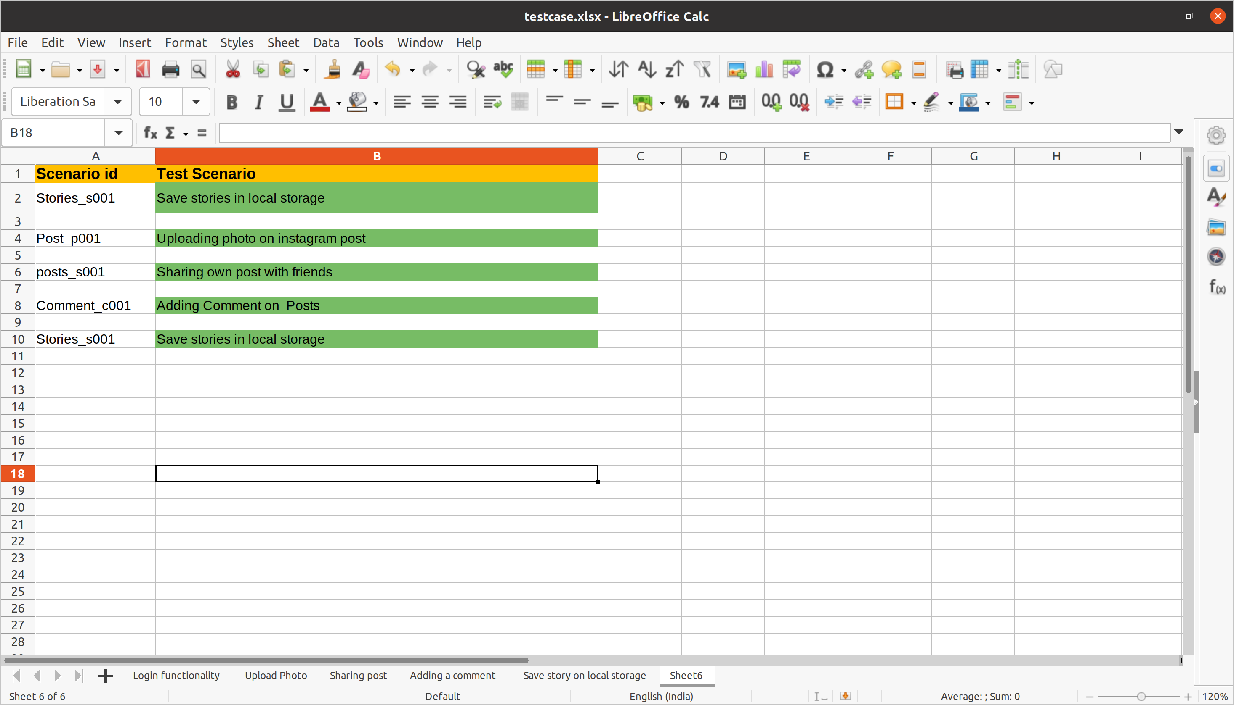
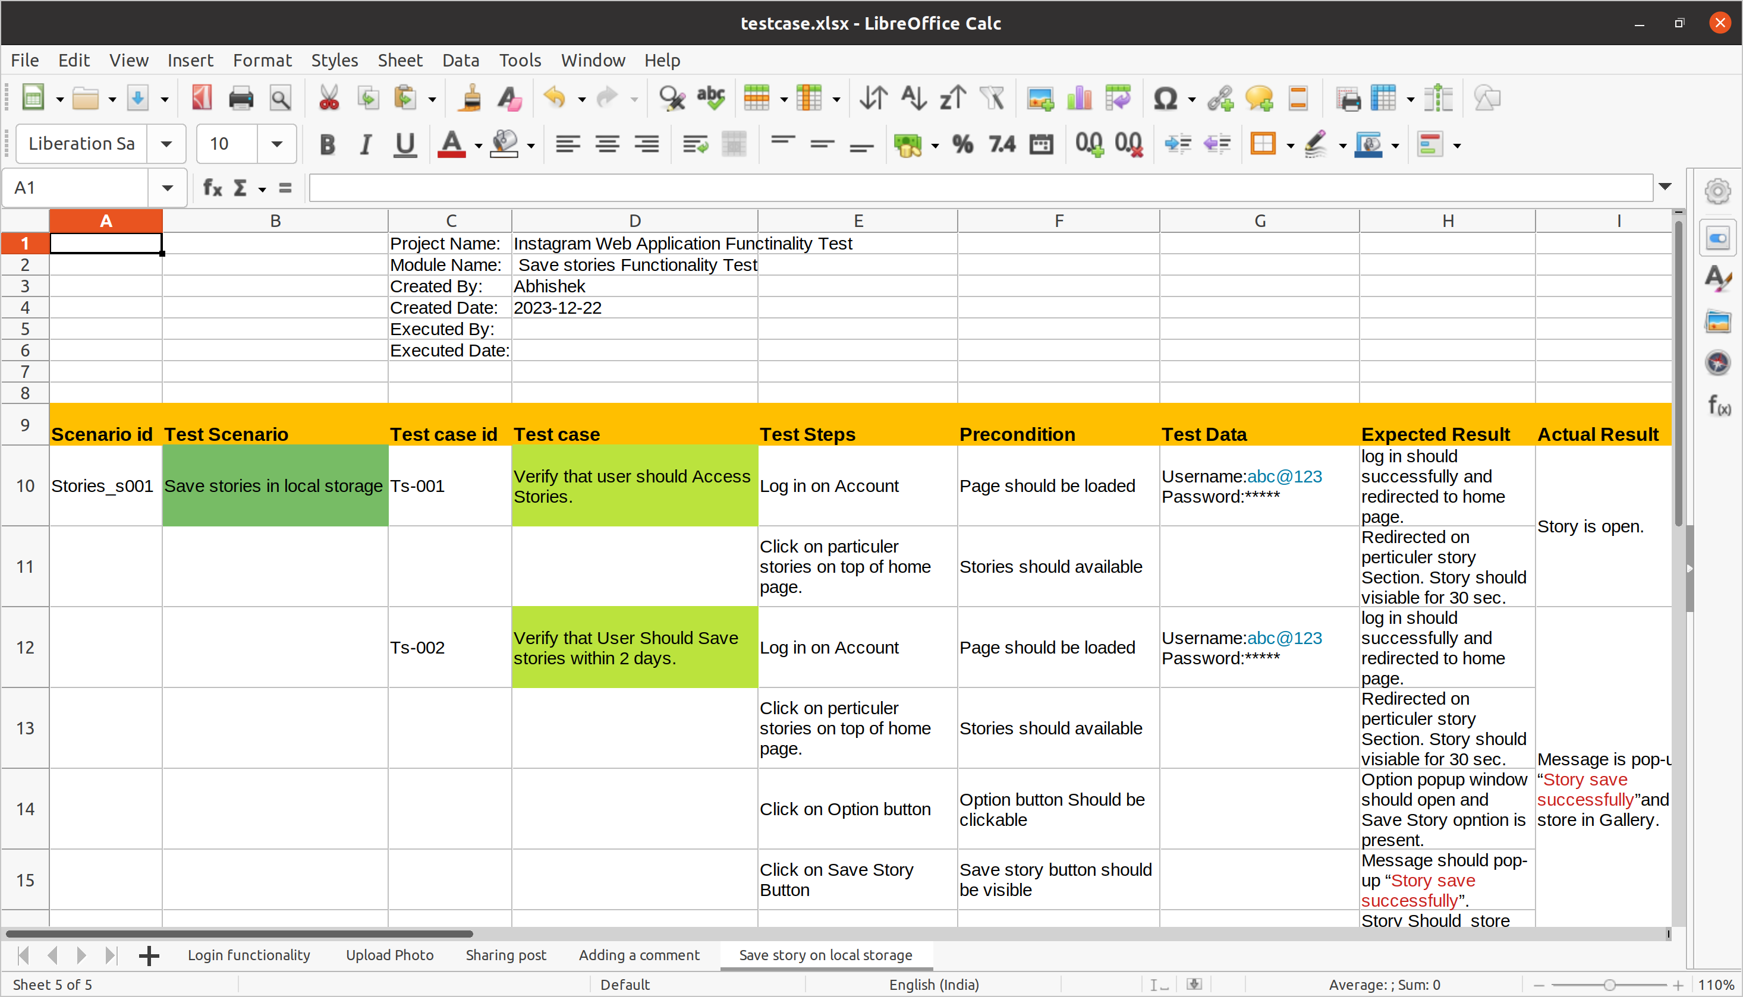
TEST DOCUMENTATION
Test Scenario
Test Case
Test Case Document Link:
https://1drv.ms/x/s!ArcqqmFm4cG7a3hTKnLGYKXeOtU?e=Ddiehs

Slide 10


Tools:
Selenium :
Selenium WebDriver is a popular open-source automation tool used for testing web applications. It provides a programming interface for interacting with web browsers, allowing developers and testers to automate browser actions, simulate user interactions, and perform functional testing.
Selenium WebDriver is primarily designed for automating the testing of web applications. It allows users to write scripts in various programming languages to interact with web elements and perform actions as a real user would.
Selenium WebDriver supports multiple programming languages, including Java, C#, Python, Ruby, and JavaScript. This makes it versatile and accessible to a wide range of developers.
Testing Instagram using Selenium :
User Authentication:
Test the login process by automating the entry of a username and password.
Verify that a user can successfully log in to their Instagram account.
Posting and Interactions:
Automate the process of creating a new post, including uploading an image or video and adding captions.
Verify that posts can be liked, commented on, and shared.
Commenting on Post:
Automating the process of adding comment on post.
Check behaviour of Application the negitive Criteria such as comment having more than limit of charecters.
Sharing post:
Automating the process of sharing post and stories feature of instagram with friends.
Benifits of Selenium:
Selenium WebDriver allows you to run tests on different web browsers, ensuring that your Instagram application functions correctly across various platforms such as Chrome, Firefox, Safari, and Edge.
Selenium WebDriver is platform-independent, meaning you can run your tests on different operating systems (Windows, Linux, macOS) without modification, ensuring a consistent user experience.
Automated testing using Selenium allows for the scalability of test cases. As your application grows, you can easily add new test scenarios to cover additional functionalities without significantly increasing testing time.

Slide 11

Postman:
Postman is a popular API development and testing tool that simplifies the process of building, testing, and documenting APIs. It provides a user-friendly interface for making HTTP requests, testing APIs, and managing the entire API development lifecycle.
Testing Instagram Using Postman:
Authentication:
Test the authentication process using Instagram's API. This may involve obtaining access tokens and refreshing tokens.
Uploading Posts:
Test creating a new post on Instagram using the API.
Comments:
Test adding comments on Instagram posts using the API.
Benefits:
Postman allows you to send HTTP requests to Instagram's API endpoints, enabling you to test various functionalities such as user authentication, media upload, post creation, and more.
Postman provides a user-friendly interface for constructing API requests and inspecting responses. You can easily validate that the responses from Instagram's API align with the expected results.
Postman supports scripting using JavaScript, allowing you to automate API tests. You can create test scripts to validate responses, handle dynamic data, and perform assertions.
Tools:

Slide 12

Jmeter:
Apache JMeter is an open-source software tool designed for performance testing and functional testing of applications. It was originally developed for testing web applications but has since expanded its capabilities to test other types of software, including databases and web services. JMeter is widely used for assessing the performance and scalability of applications under various conditions.
Testing Instagram Using Postman:
User Authentication:
Test the authentication process using Instagram's API, including obtaining access tokens.
Posts:
Test creating a new post on Instagram using the API.
Comments:
Simulate adding comments on Instagram posts using the API.
Benefits:
JMeter allows you to simulate a large number of virtual users, helping you assess how Instagram handles heavy loads. This is crucial for identifying potential bottlenecks and understanding the application's scalability.
JMeter can simulate extreme load conditions to stress test Instagram, revealing the point at which the application starts to degrade in performance or fail. This helps in understanding system limitations and potential failure points.
JMeter provides detailed performance metrics such as response times, throughput, and error rates. These metrics help in evaluating the overall performance and responsiveness of Instagram under different scenarios.
Tools:

Slide 13
Appium:
Appium is an open-source automation framework for mobile applications, allowing you to automate testing of native, hybrid, and mobile web applications on various platforms. It supports both Android and iOS platforms, making it a versatile choice for mobile app testing.
Benefites:
Appium supports cross-platform mobile app testing, allowing you to write test scripts once and execute them on both Android and iOS devices. This helps in achieving efficient test coverage across multiple platforms.
Appium allows testing of mobile applications without requiring any modification to the app's source code. This is beneficial as it allows testing in the app's natural state, ensuring that the automation process does not interfere with the app's behavior.
Appium is compatible with various programming languages, including Java, Python, Ruby, JavaScript, and C#. This flexibility allows teams to use the language they are most comfortable with or that best fits their project requirements.
Cypress:
Cypress is an open-source end-to-end testing framework designed for modern web applications. It simplifies the process of testing web applications by providing a fast, reliable, and easy-to-use platform. Cypress is known for its unique architecture and features that make it particularly well-suited for both developers and testers.
Benefites:
Cypress executes tests directly in the browser, allowing for faster test execution. This is particularly advantageous for large test suites, contributing to quicker feedback during development.
Cypress provides real-time reloads during test development. Changes made to test scripts are instantly reflected in the browser, making the development and debugging process more efficient.
Cypress intelligently waits for elements to appear and become interactable, eliminating the need for explicit waits or sleeps in test scripts. This improves test reliability and reduces the likelihood of flaky tests.
Other Tools:

Slide 14
Knightwatchjs:
Nightwatch enables automation testing of native mobile applications via Appium. It combines the robustness of Appium with the enhanced developer experience provided by Nightwatch. It enables end-to-end functional testing of native mobile apps on Android and iOS devices.
Benefits:
Built-in test runner. Built-in command-line test runner can run the tests either sequentially or in parallel, together, by group, tags, or single.
Nightwatch.js automatically manages the WebDriver services (Edge, Safari, GeckoDriver).
Cloud services support. Works with cloud testing providers, such as SauceLabs and BrowserStack.
Includes its own testing framework / assertions library. Clean syntax. Simple but powerful syntax enables you to write tests very quickly.
Other Tools:

